Slide 1
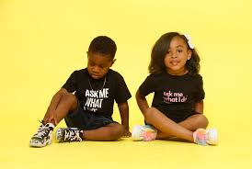
CONTENTS
INTRODUCTION
OVERVIEW
PURPOSE

Slide 2
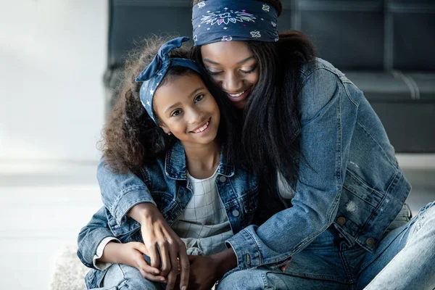
TINY HUG
TINY HUG

Slide 3
TINY HUG
PURPOSE
MINIAL

Slide 4
PURPOSE
To Give Voice to kids
Save money
Greate large sales
encouragement

Slide 5
TO GIVE PARENTS AND KIDS VOICE IN THE FASHION INUDSTRY
More parents online
Less fashion websites for kids
Attention for kids

Slide 6
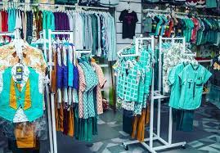
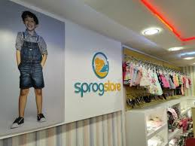
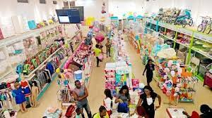
Our
competitors

Slide 8
